Slide 1

Chapter 4 The Queue ADT

Slide 2
Chapter 4: The Queue ADT
4.1 – The Queue
4.2 – The Queue Interface
4.3 – Array-Based Queue Implementations
4.4 – An Interactive Test Driver
4.5 – Link-Based Queue Implementations
4.6 – Application: Palindromes
4.7 – Queue Variations
4.8 – Application: Average Waiting Time
4.9 – Concurrency, Interference, and
Synchronization

Slide 3
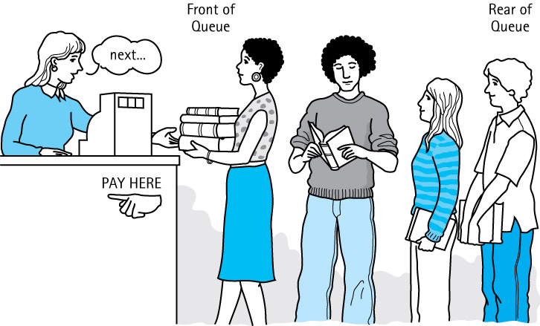
4.1 The Queue
Queue A structure in which elements are added to the rear and removed from the front; a “first in, first out” (FIFO) structure

Slide 4
Operations on Queues
Constructor
new - creates an empty queue
Transformers
enqueue - adds an element to the rear of a queue
dequeue - removes and returns the front element of the queue

Slide 5
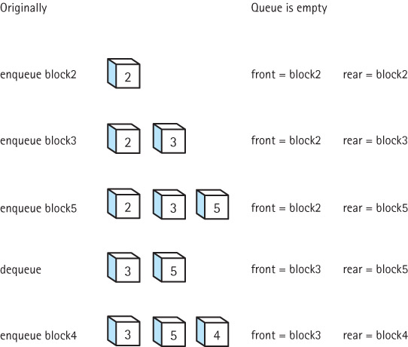
Effects of
Queue
Operations

Slide 6
Using Queues
Operating systems often maintain a queue of processes that are ready to execute or that are waiting for a particular event to occur.
Computer systems must often provide a “holding area” for messages between two processes, two programs, or even two systems. This holding area is usually called a “buffer” and is often implemented as a queue.
Our software queues have counterparts in real world queues. We wait in queues to buy pizza, to enter movie theaters, to drive on a turnpike, and to ride on a roller coaster. Another important application of the queue data structure is to help us simulate and analyze such real world queues

Slide 7
4.2 The Queue Interface
We use a similar approach as with the Stack ADT.
Our queues
are generic
queue related classes are held in ch04.queues package
we define exceptions for both queue underflow and queue overflow
we create a QueueInterface

Slide 8
QueueInterface
package ch04.queues;
public interface QueueInterface<T>
{
void enqueue(T element) throws QueueOverflowException1;
// Throws QueueOverflowException if this queue is full;
// otherwise, adds element to the rear of this queue.
T dequeue() throws QueueUnderflowException;
// Throws QueueUnderflowException if this queue is empty;
// otherwise, removes front element from this queue and returns it.
boolean isFull();
// Returns true if this queue is full;
// otherwise, returns false.
boolean isEmpty();
// Returns true if this queue is empty;
// otherwise, returns false.
int size();
// Returns the number of elements in this queue.
}

Slide 9
Example Use of a Queue
Instructors can now review and demonstrate the RepeatStrings application found in package ch04.apps.

Slide 10
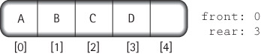
4.3 Array-Based Queue Implementations
In this section we study two array-based implementations of the Queue ADT
a bounded queue version
an unbounded queue version
We simplify some figures by using a capital letter to represent an element’s information

Slide 11
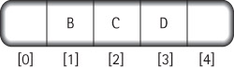
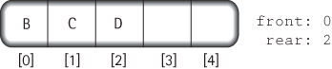
Fixed Front Design
After four calls to enqueue with arguments ‘A’, ‘B’, ‘C’, and ‘D’:
Dequeue the front element:
Move every element in the queue up one slot
The dequeue operation is inefficient, so we do not use this approach

Slide 12
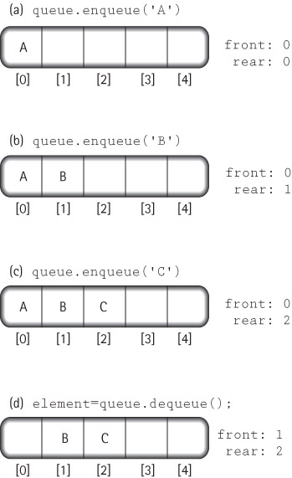
Floating Front Design
We use this
approach

Slide 13
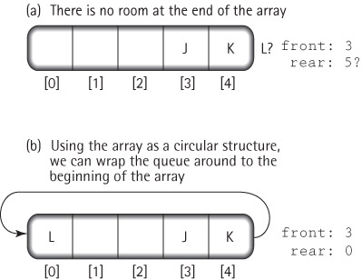
Wrap Around with Floating Front Design

Slide 14
The ArrayBoundedQueue Class
package ch04.queues;
public class ArrayBoundedQueue<T> implements QueueInterface<T>
{
protected final int DEFCAP = 100; // default capacity
protected T[] elements; // array that holds queue elements
protected int numElements = 0; // number of elements in the queue
protected int front = 0; // index of front of queue
protected int rear; // index of rear of queue
public ArrayBoundedQueue()
{
elements = (T[]) new Object[DEFCAP];
rear = DEFCAP - 1;
}
public ArrayBounddQueue(int maxSize)
{
elements = (T[]) new Object[maxSize];
rear = maxSize - 1;
}

Slide 15
The enqueue operation
public void enqueue(T element)
// Throws QueueOverflowException if this queue is full,
// otherwise adds element to the rear of this queue.
{
if (isFull())
throw new QueueOverflowException("Enqueue attempted on a full queue.");
else
{
rear = (rear + 1) % elements.length;
elements[rear] = element;
numElements = numElements + 1;
}
}

Slide 16
The dequeue operation
public T dequeue()
// Throws QueueUnderflowException if this queue is empty,
// otherwise removes front element from this queue and returns it.
{
if (isEmpty())
throw new QueueUnderflowException(“Dequeue attempted on empty queue.”);
else
{
T toReturn = elements[front];
elements[front] = null;
front = (front + 1) % elements.length;
numElements = numElements - 1;
return toReturn;
}
}

Slide 17
Remaining Queue Operations (observers)
public boolean isEmpty()
// Returns true if this queue is empty, otherwise returns false
{
return (numElements == 0);
}
public boolean isFull()
// Returns true if this queue is full, otherwise returns false.
{
return (numElements == elements.length);
}
public int size()
// Returns the number of elements in this queue.
{
return numElements;
}

Slide 18
The ArrayUnboundedQueue Class
The trick is to create a new, larger array, when needed, and copy the queue into the new array
Since enlarging the array is conceptually a separate operation from enqueing, we implement it as a separate enlarge method
This method instantiates an array with a size equal to the current capacity plus the original capacity
We change the isFull method so that it always returns false, since an unbounded queue is never full
The dequeue and isEmpty methods are unchanged

Slide 19
The ArrayUnbndQueue Class
package ch04.queues;
public class ArrayUnboundedQueue<T> implements QueueInterface<T>
{
protected final int DEFCAP = 100; // default capacity
protected T[] elements; // array that holds queue elements
protected int origCap; // original capacity
protected int numElements = 0; // number of elements in the queue
protected int front = 0; // index of front of queue
protected int rear; // index of rear of queue
public ArrayUnboundedQueue()
{
elements = (T[]) new Object[DEFCAP];
rear = DEFCAP - 1;
origCap = DEFCAP;
}
public ArrayUnboundedQueue(int origCap)
{
elements = (T[]) new Object[origCap];
rear = origCap - 1;
this.origCap = origCap;
}

Slide 20
The enlarge operation
private void enlarge()
// Increments the capacity of the queue by an amount
// equal to the original capacity.
{
// create the larger array
T[] larger = (T[]) new Object[elements.length + origCap];
// copy the contents from the smaller array into the larger array
int currSmaller = front;
for (int currLarger = 0; currLarger < numElements; currLarger++)
{
larger[currLarger] = elements[currSmaller];
currSmaller = (currSmaller + 1) % elements.length;
}
// update instance variables
elements = larger;
front = 0;
rear = numElements - 1;
}

Slide 21
The enqueue operation
public void enqueue(T element)
// Adds element to the rear of this queue.
{
if (numElements == elements.length)
enlarge();
rear = (rear + 1) % elements.length;
elements[rear] = element;
numElements = numElements + 1;
}

Slide 22
4.4 An Interactive Test Driver
Act as an example use of the ArrayBoundedQueue class
Can be used by students to experiment and learn about the Queue ADT and the relationships among its exported methods
Will use elements of type String to be stored and retrieved from the ADT

Slide 23
The General Approach
Prompt for, read, and display test name
Determine which constructor to use
Obtain needed parameters
Instantiate a new instance of the ADT
while (testing continues)
{
Display a menu of operation choices,
one choice for each method exported by the ADT
plus a “stop testing” choice
Get the user’s choice and
obtain any needed parameters
Perform the chosen operation
if an exception is thrown, catch it and
report its message
if a value is returned, report it
}

Slide 24
Instructors can now walk through the code contained in ITDArrayBoundedQueue.java found in the ch04.queues package and demonstrate the running program.

Slide 25
4.5 Link-Based Queue Implementations
In this section we develop a link-based implementation of an unbounded queue, and discuss a second link-based approach.
For nodes we use the same LLNode class we used for the linked implementation of stacks.
After discussing the link-based approaches we compare all of our queue implementation approaches.

Slide 26
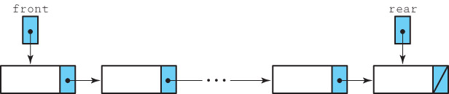
The LinkedQueue Class
package ch04.queues;
import support.LLNode;
public class LinkedQueue<T> implements QueueInterface<T>
{
protected LLNode<T> front; // reference to the front of this queue
protected LLNode<T> rear; // reference to the rear of this queue
protected int numElements = 0; // number of elements in this queue
public LinkedQueue()
{
front = null; rear = null;
}
. . .

Slide 27
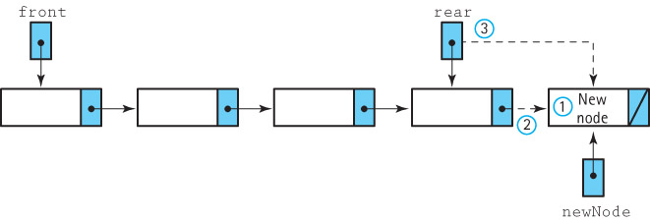
The enqueue operation
Enqueue (element)
1. Create a node for the new element
2. Add the new node at the rear of the queue
3. Update the reference to the rear of the queue
4. Increment the number of elements

Slide 28
Code for the enqueue method
public void enqueue(T element)
// Adds element to the rear of this queue.
{
LLNode<T> newNode = new LLNode<T>(element);
if (rear == null)
front = newNode;
else
rear.setLink(newNode);
rear = newNode;
numElements++;
}

Slide 29
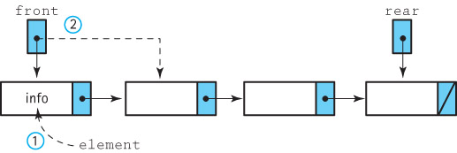
The dequeue operation
Dequeue: returns Object
1. Set element to the information in the front node
2. Remove the front node from the queue
3. if the queue is empty
Set the rear to null
4. Decrement the number of elements
5. return element

Slide 30
Code for the dequeue method
public T dequeue()
// Throws QueueUnderflowException if this queue is empty,
// otherwise removes front element from this queue and returns it.
{
if (isEmpty())
throw new QueueUnderflowException("Dequeue attempted on empty queue.");
else
{
T element;
element = front.getInfo();
front = front.getLink();
if (front == null)
rear = null;
numElements--;
return element;
}
}

Slide 31
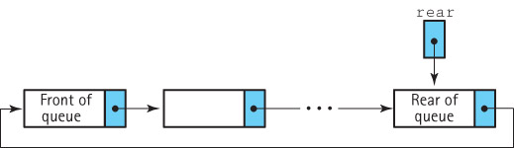
An Alternative Approach - A Circular Linked Queue

Slide 32
Comparing Queue Implementations
Storage Size
Array-based: takes the same amount of memory, no matter how many array slots are actually used, proportional to current capacity
Link-based: takes space proportional to actual size of the queue (but each element requires more space than with array approach)
Operation efficiency
All operations, for each approach, are O(1)
Except for the Constructors:
Array-based: O(N)
Link-based: O(1)
Special Case – For the ArrayUnboundedQueue the size “penalty” can be minimized but the enlarge method is O(N)

Slide 33
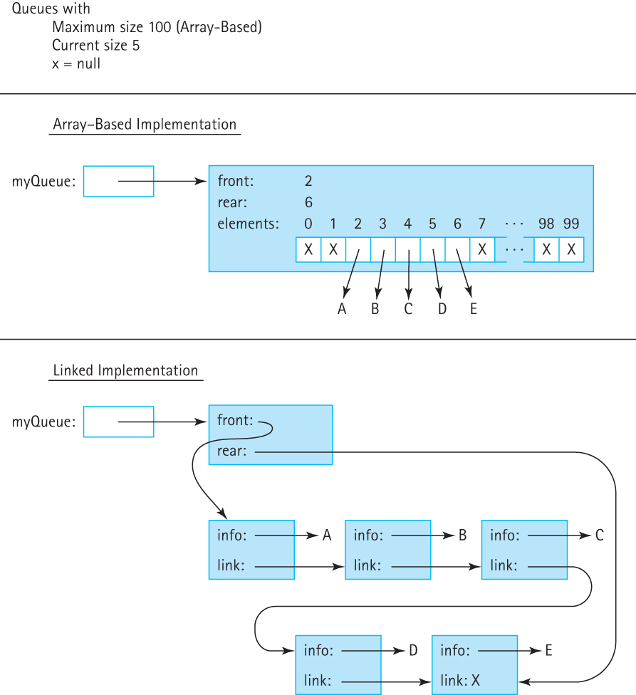
Comparing Queue Implementations

Slide 34
4.6 Application: Palindromes
Examples
A tribute to Teddy Roosevelt, who orchestrated the creation of the Panama Canal:
A man, a plan, a canal—Panama!
Allegedly muttered by Napoleon Bonaparte upon his exile to the island of Elba:
Able was I ere, I saw Elba.
Our goal is to write a program that identifies Palindromic strings
we ignore blanks, punctuation and the case of letters

Slide 35
The Palindrome Class
To help us identify palindromic strings we create a class called Palindrome, with a single exported static method test
test takes a candidate string argument and returns a boolean value indicating whether the string is a palindrome
Since test is static we invoke it using the name of the class rather than instantiating an object of the class
The test method uses both the stack and queue data structures

Slide 36
The test method approach
The test method creates a stack and a queue
It then repeatedly pushes each input letter onto the stack, and also enqueues the letter onto the queue
It discards any non-letter characters
To simplify comparison later, we push and enqueue only lowercase versions of the characters
After the characters of the candidate string have been processed, test repeatedly pops a letter from the stack and dequeues a letter from the queue
As long as these letters match each other the entire way through this process, we have a palindrome

Slide 37
Test for Palindrome (String candidate)
Create a new stack
Create a new queue
for each character in candidate
if the character is a letter
Change the character to lowercase
Push the character onto the stack
Enqueue the character onto the queue
Set stillPalindrome to true
while (there are still more characters in the structures
&& stillPalindrome)
Pop fromStack from the stack
Dequeue fromQueue from the queue
if (fromStack != fromQueue)
Set stillPalindrome to false
return (stillPalindrome)

Slide 38
Code and Demo
Instructors can now walk through the code contained in Palindrome.java in the ch04.palindromes package, and PalindromeCLI.java and/or Palindrome.GUI both in the ch04.apps package, and demonstrate the application.

Slide 39
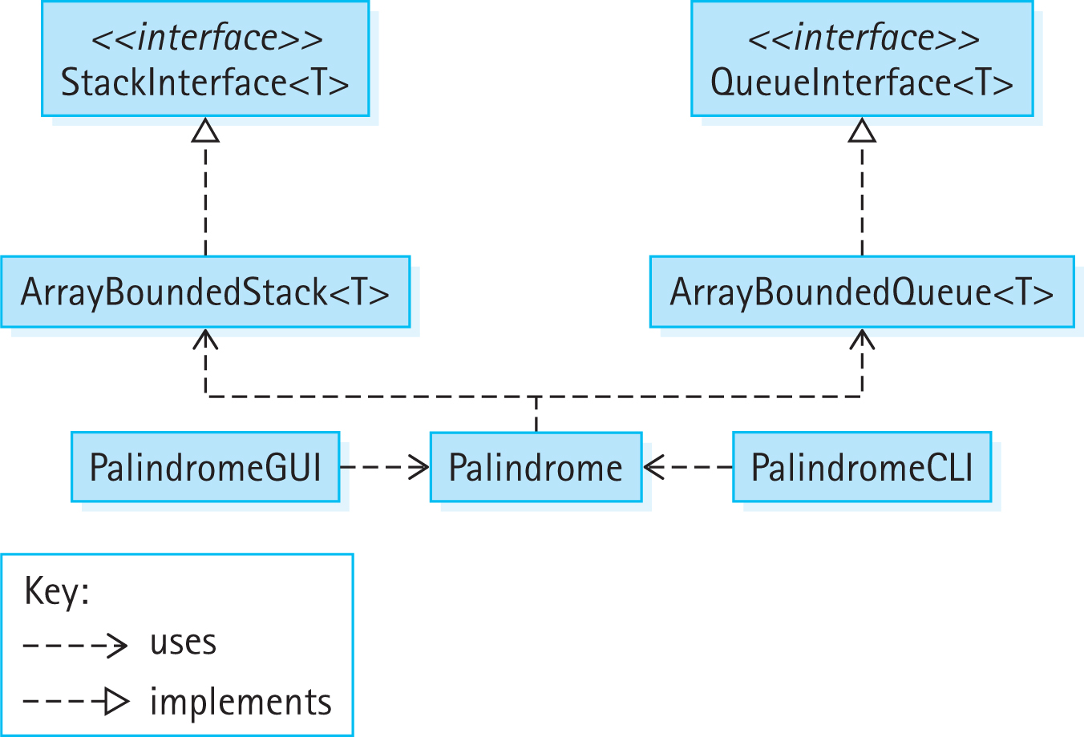
Program Architecture

Slide 40
4.7 Queue Variations
We consider some alternate ways to define the classic queue operations.
We look at additional operations that could be included in a Queue ADT, some that allow us to “peek” into the queue and others that expand the access rules
We review the Java Standard Library queue support.

Slide 41
Exceptional Situations
Our queues throw exceptions in the case of underflow or overflow.
Another approach is to prevent the over/underflow from occurring by nullifying the operation, and returning a value that indicates failure
boolean enqueue(T element) adds element to the rear of this queue; returns true if element is successfully added, false otherwise
T dequeue()returns null if this queue is empty, otherwise removes front element from this queue and returns it

Slide 42
Inheritance of Interfaces
Java supports inheritance of interfaces.
In fact, the language supports multiple inheritance of interfaces—a single interface can extend any number of other interfaces.
Suppose interface B extends interface A. Then a class that implements interface B must provide concrete methods for all of the abstract methods listed in both interface B and interface A.

Slide 43
The Glass Queue
//-------------------------------------------------------------------------// GlassQueueInterface.java by Dale/Joyce/Weems Chapter 4
//
// Interface for a class that implements a queue of T and includes
// operations for peeking at the front and rear elements of the queue.
//-------------------------------------------------------------------------
package ch04.queues;
public interface GlassQueueInterface<T> extends QueueInterface<T>
{
public T peekFront();
// If the queue is empty, returns null.
// Otherwise, returns the element at the front of this queue.
public T peekRear();
// If the queue is empty, returns null.
// Otherwise, returns the element at the rear of this queue.
}

Slide 44
package ch04.queues;
public class LinkedGlassQueue<T> extends LinkedQueue<T>
implements GlassQueueInterface<T>
{
public LinkedGlassQueue()
{
super();
}
public T peekFront()
{
if (isEmpty())
return null;
else
return front.getInfo();
}
public T peekRear()
{
if (isEmpty())
return null;
else
return rear.getInfo();
}
}

Slide 45
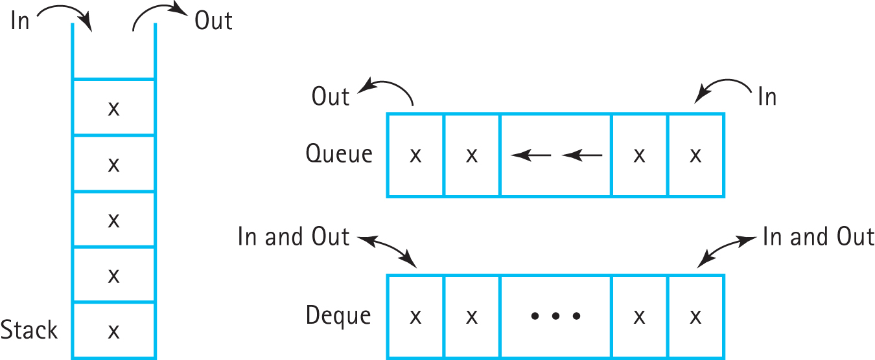
The Double-Ended Queue: Deque

Slide 46
package ch04.queues;
public interface DequeInterface<T>
{
void enqueueFront(T element) throws QueueOverflowException;
// Throws QueueOverflowException if this queue is full;
// otherwise, adds element to the front of this queue.
void enqueueRear(T element) throws QueueOverflowException;
// Throws QueueOverflowException if this queue is full;
// otherwise, adds element to the rear of this queue.
T dequeueFront() throws QueueUnderflowException;
// Throws QueueUnderflowException if this queue is empty;
// otherwise, removes front element from this queue and returns it.
T dequeueRear() throws QueueUnderflowException;
// Throws QueueUnderflowException if this queue is empty;
// otherwise, removes rear element from this queue and returns it.
boolean isFull();
boolean isEmpty();
int size();
}

Slide 47
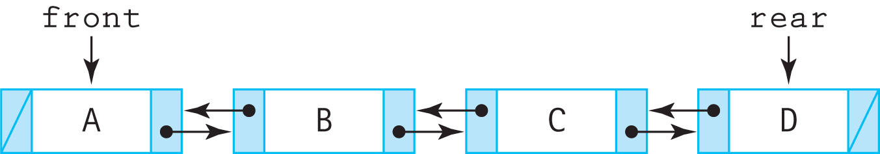
A good approach for implementing Deque
Double Linked List:
See DLLNode in package support

Slide 48
Queues in the Java Standard Library
A Queue interface was added to the Java Library Collection Framework with Java 5.0 in 2004.
Elements are always removed from the “front” of the queue.
Two operations for enqueuing: add, that throws an exception if invoked on a full queue, and offer, that returns a boolean value of false if invoked on a full queue.

Slide 49
Queues in the Java Standard Library
As with the library Stack, the library Queue was supplanted by the Deque with the release of Java 6.0 in 2006
it requires operations allowing for additions, deletions, and inspections at both ends of the queue
There are four library classes that implement the Deque interface: ArrayDeque, ConcurrentLinkedDeque, LinkedBlockingDeque, and LinkedList.

Slide 50
4.8 Application: Average Waiting Time
We create a program that simulates a series of customers arriving for service, entering a queue, waiting, being served, and finally leaving the queue.
It tracks the time the customers spend waiting in queues and outputs the average waiting time.

Slide 51
Definitions
Arrival time: the time a customers arrives
Service time: time customer needs
Departure time: the time customer leaves
Turnaround time: Departure time – Arrival time
Wait time: Turnaround time – Service Time

Slide 52
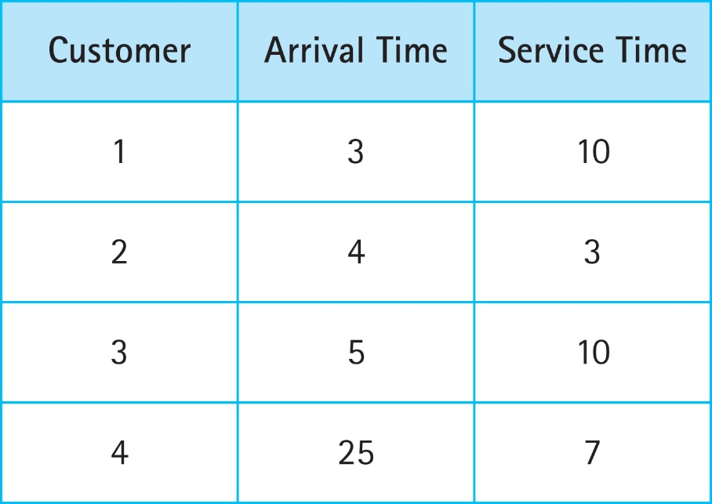
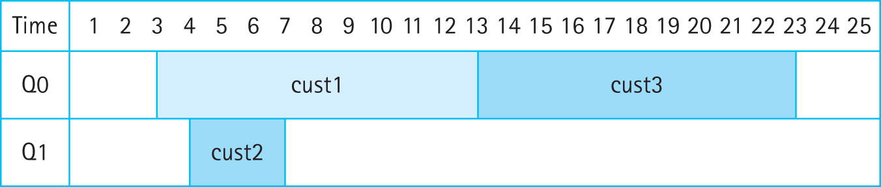
Simple Example
And so on

Slide 53
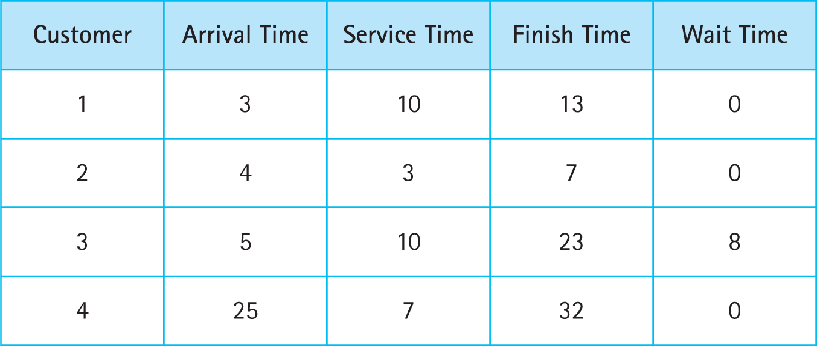
Simple Example Results

Slide 54
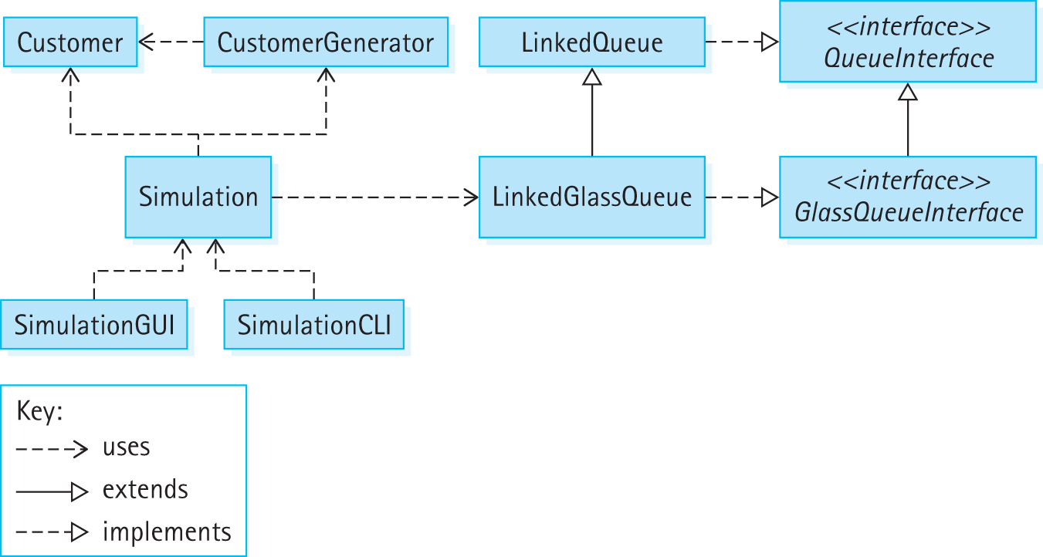
Program Architecture

Slide 55
Sample Run of SimulationCLI
Enter minimum interarrival time: 0
Enter maximum interarrival time: 10
Enter minimum service time: 5
Enter maximum service time: 20
Enter number of queues: 2
Enter number of customers: 2000
Average waiting time is 1185.632
Evaluate another simulation instance? (Y=Yes): y
Enter number of queues: 3
Enter number of customers: 2000
Average waiting time is 5.7245
Evaluate another simulation instance? (Y=Yes): n
Program completed.

Slide 56
4.9 Concurrency, Interference, and Synchronization
Multitask: Perform more than one task at a time
Concurrency: Several interacting code sequences are executing simultaneously
through interleaving of statements by a single processor
through execution on several processors

Slide 57
Counter Class
//-------------------------------------------------------------------------
// Counter.java by Dale/Joyce/Weems Chapter 4
//
// Tracks the current value of a counter.
//-------------------------------------------------------------------------
package ch04.threads;
public class Counter
{
private int count;
public Counter()
{
count = 0;
}
public void increment()
{
count++;
}
public int getCount()
{
return count;
}
}

Slide 58
Demo One - Basic
package ch04.concurrency;
import ch04.threads.*;
public class Demo01
{
public static void main(String[] args)
{
Counter c = new Counter();
c.increment();
c.increment();
c.increment();
System.out.println("Count is: " + c.getCount()); }
}
The output of the program: Count is: 3

Slide 59
Demo Two - Threads
package ch04.threads;
public class Increase
implements Runnable
{
private Counter c;
private int amount;
public Increase (Counter c, int amount)
{
this.c = c; this.amount = amount;
}
public void run()
{
for (int i = 1; i <= amount; i++)
c.increment();
}
}
package ch04.concurrency;
import ch04.threads.*;
public class Demo02
{
public static void main(String[] args) throws InterruptedException
{
Counter c = new Counter();
Runnable r = new Increase(c, 10000);
Thread t = new Thread(r);
t.start();
System.out.println("Count is: " + c.getCount());
}
}
Output Varies: 86, 3024, 457 ????

Slide 60
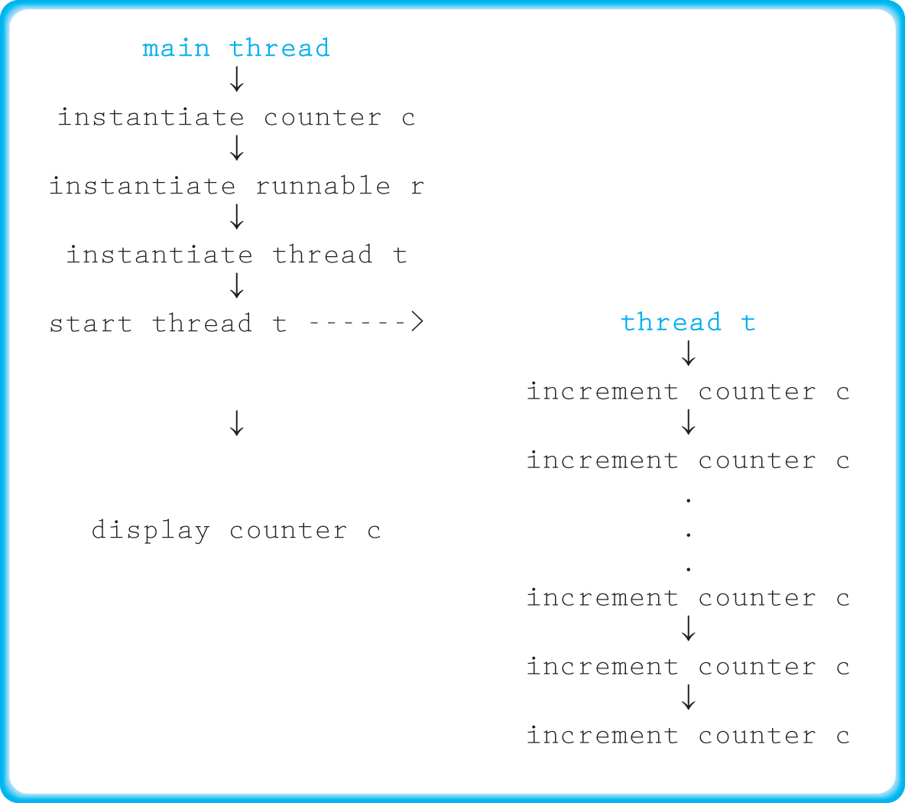
Demo Two - Threads

Slide 61
Demo Three - Join
package ch04.threads;
public class Increase
implements Runnable
{
private Counter c;
private int amount;
public Increase (Counter c, int amount)
{
this.c = c; this.amount = amount;
}
public void run()
{
for (int i = 1; i <= amount; i++)
c.increment();
}
}
package ch04.concurrency;
import ch04.threads.*;
public class Demo03
{
public static void main(String[] args) throws InterruptedException
{
Counter c = new Counter();
Runnable r = new Increase(c, 10000);
Thread t = new Thread(r);
t.start();
t.join();
System.out.println("Count is: " + c.getCount());
}
}
Output is 10000

Slide 62
Demo Four - Interference
package ch04.threads;
public class Increase
implements Runnable
{
private Counter c;
private int amount;
public Increase (Counter c, int amount)
{
this.c = c; this.amount = amount;
}
public void run()
{
for (int i = 1; i <= amount; i++)
c.increment();
}
}
package ch04.concurrency;
import ch04.threads.*;
public class Demo04
{
public static void main(String[] args)
throws InterruptedException
{
Counter c = new Counter();
Runnable r1 = new Increase(c, 5000);
Runnable r2 = new Increase(c, 5000);
Thread t1 = new Thread(r1);
Thread t2 = new Thread(r2);
t1.start(); t2.start();
t1.join(); t2.join();
System.out.println("Count is: " + c.getCount());
}
}
Output Varies: 9861, 9478 ????

Slide 63
Demo Four - Interference
Thread t1 Thread t2
Step 1: obtains value 12
Step 2: obtains value 12
Step 3: increments value to 13
Step 4: stores the value 13
Step 5: increments value to 13
Step 6: stores the value 13

Slide 64
Demo Five - Synchronization
// SyncCounter.java
// Tracks the current value of a counter.
// Provides synchronized access
package ch04.threads;
public class SyncCounter
{
private int count;
public SyncCounter()
{
count = 0;
}
public synchronized void increment()
{
count++;
}
public int getCount()
{
return count;
}
}
// The IncreaseSync class is identical to Increase
// cass except that it accepts a SyncCounter instead
// of Counter as its first parameter
package ch04.concurrency;
import ch04.threads.*;
public class Demo05
{
public static void main(String[] args) throws InterruptedException
{
SyncCounter sc = new SyncCounter();
Runnable r1 = new IncreaseSync(sc, 5000);
Runnable r2 = new IncreaseSunc(sc, 5000);
Thread t1 = new Thread(r1);
Thread t2 = new Thread(r2);
t1.start(); t2.start();
t1.join(); t2.join();
System.out.println("Count is: " + sc.getCount());
}
}
Output is 10000

Slide 65
A Synchronized Queue
Similarly the synchronized keyword can be used to control access to an entire or selected parts of a data structure
See the subsection “A Synchronized Queue”

Slide 66
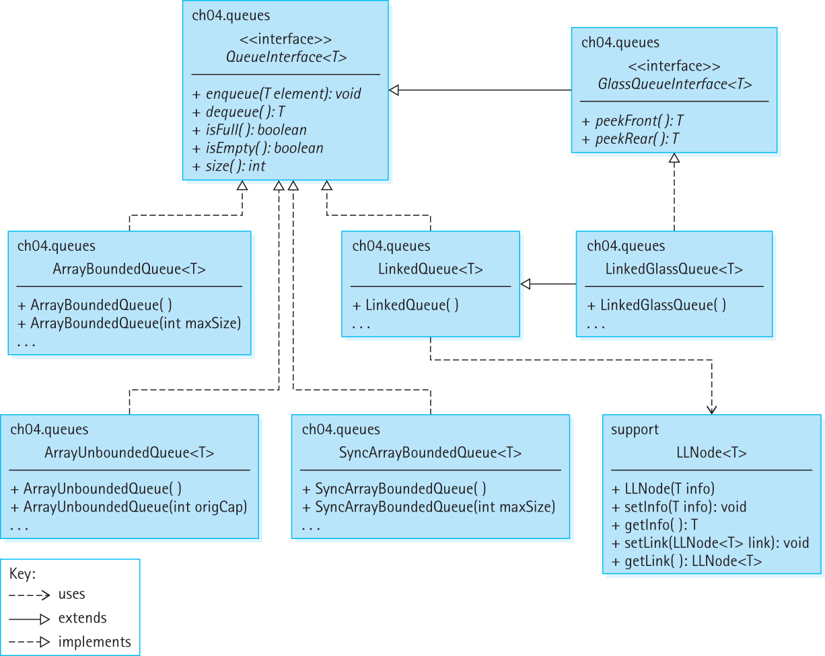
Our Queue Architecture

